Slide 1
Apache Spark-2

Slide 2
Apache Spark RDD
In Apache Spark, RDD is a fault-tolerant collection of elements for in-memory cluster computing.
Spark RDD can contain Objects of any type.
There are two types of RDD Operations.
Transformations : Create a new RDD from an existing RDD
Actions : Run a computation or aggregation on the RDD and return a value to the driver program

Slide 3
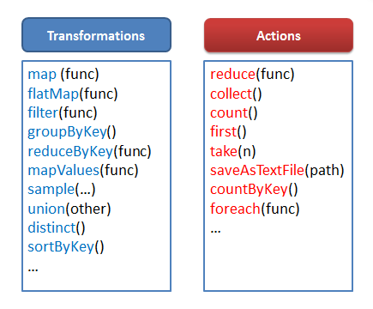

Slide 4
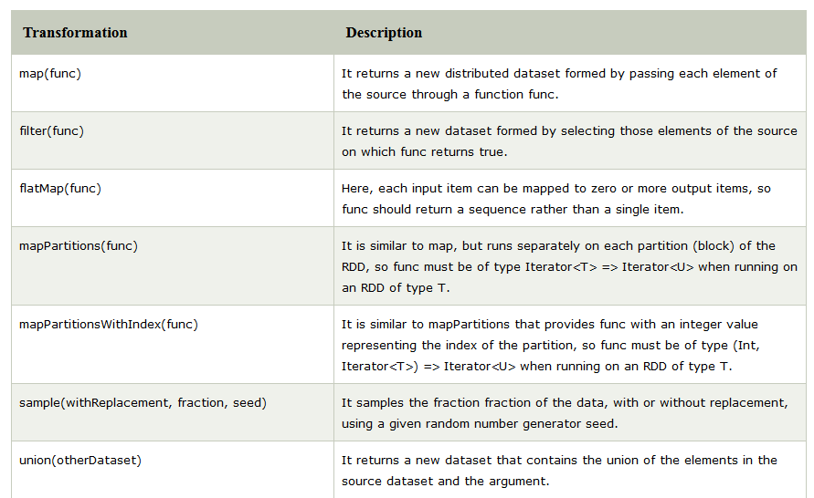

Slide 5
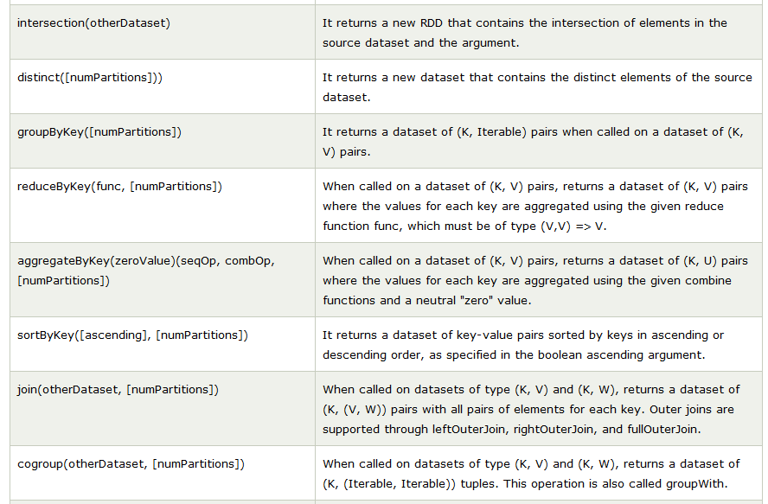

Slide 6
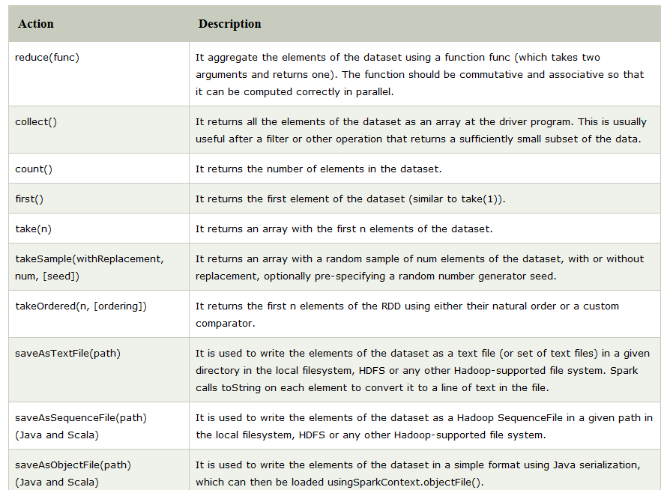

Slide 7
Transformations
Narrow transformation – In Narrow transformation, all the elements that are required to compute the records in single partition live in the single partition of parent RDD. A limited subset of partition is used to calculate the result. Narrow transformations are the result of map(), filter().
wide transformation - all the elements that are required to compute the records in the single partition may live in many partitions of parent RDD. The partition may live in many partitions of parent RDD. Wide transformations are the result of groupbyKey() and reducebyKey().

Slide 8
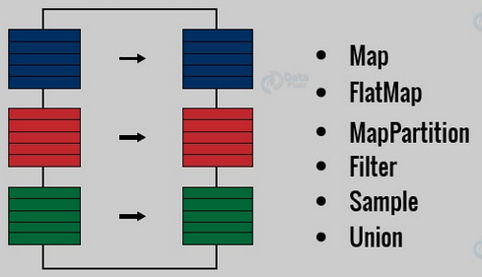
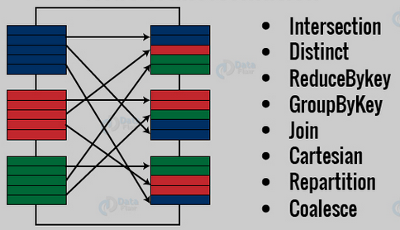

Slide 9
Spark Interface
RDD
There are following ways to create RDD in Spark are:
1.Using parallelized collection.
2.From external datasets (Referencing a dataset in external storage system ).
3.From existing apache spark RDDs.

Slide 10
Using Parallelized collection
RDDs can be created generally by the parallelizing method. It is possible by taking an existing collection from our driver program. Driver program such as Scala, Python, Java. Also by calling the sparkcontext’s parallelize( ) method on it.
This is a basic method to create RDD which is applied at the very initial stage of spark. It creates RDD very quickly. It also initializes further operations on them at the same time. To operate this method, we need entire dataset on one machine. Due to this property, this process is rarely used outside of testing and prototyping.

Slide 11
Parallelized collection (parallelizing)
In the initial stage when we learn Spark, RDDs are generally created by parallelized collection i.e. by taking an existing collection in the program and passing it to SparkContext’s parallelize() method. This method is used in the initial stage of learning Spark since it quickly creates our own RDDs in Spark shell and performs operations on them. This method is rarely used outside testing and prototyping because this method requires entire dataset on one machine. Consider the following example of sortByKey(). In this, the data to be sorted is taken through parallelized collection:

Slide 12
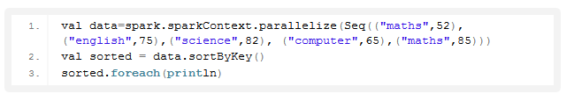

Slide 13
The key point to note in parallelized collection is the number of partition the dataset is cut into. Spark will run one task for each partition of cluster. We require two to four partitions for each CPU in cluster. Spark sets number of partition based on our cluster. But we can also manually set the number of partitions. This is achieved by passing number of partition as second parameter to parallelize . e.g. sc.parallelize(data, 10), here we have manually given number of partition as 10. Consider one more example, here we have used parallelized collection and manually given the number of partitions:

Slide 14
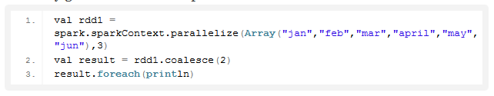

Slide 15
External Datasets (Referencing a dataset)
In Spark, the distributed dataset can be formed from any data source supported by Hadoop, including the local file system, HDFS, Cassandra, HBase etc. In this, the data is loaded from the external dataset. To create text file RDD, we can use SparkContext’s textFile method. It takes URL of the file and read it as a collection of line. URL can be a local path on the machine or a hdfs://, s3n://, etc. The point to jot down is that the path of the local file system and worker node should be the same. The file should be present at same destinations both in the local file system and worker node. We can copy the file to the worker nodes or use a network mounted shared file system.

Slide 16
DataFrameReader Interface is used to load a Dataset from external storage systems (e.g. file systems, key-value stores, etc). Use SparkSession.read to access an instance of DataFrameReader.DataFrameReader supports many file formats-

Slide 17
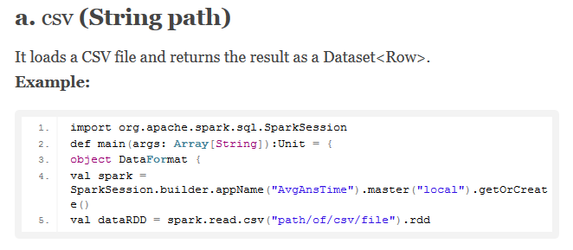

Slide 18
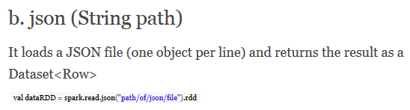
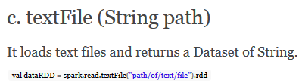

Slide 19
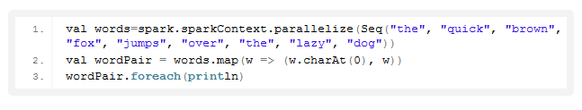
Creating RDD from existing RDD
Transformation mutates one RDD into another RDD, thus transformation is the way to create an RDD from already existing RDD. This creates difference between Apache Spark and Hadoop MapReduce. Transformation acts as a function that intakes an RDD and produces one. The input RDD does not get changed, because RDDs are immutable in nature but it produces one or more RDD by applying operations. Some of the operations applied on RDD are: filter, count, distinct, Map, FlatMap etc.

Slide 20

Create a new RDD
Read File from local filesystem and create an RDD.
Note: sc is the object of SparkContext
Note: You need to create a file data.txt in Spark_Home directory
b) Create an RDD through Parallelized Collection
C) From Existing RDDs

Slide 21
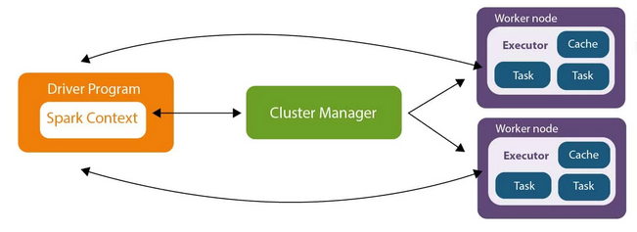
Apache Spark Architecture

Slide 22
Driver Program
Driver Program in the Apache Spark architecture calls the main program of an application and creates SparkContext. A SparkContext consists of all the basic functionalities. Spark Driver contains various other components such as DAG Scheduler, Task Scheduler, Backend Scheduler, and Block Manager, which are responsible for translating the user-written code into jobs that are actually executed on the cluster

Slide 23
Spark Driver and SparkContext collectively watch over the job execution within the cluster. Spark Driver works with the Cluster Manager to manage various other jobs. Cluster Manager does the resource allocating work. And then, the job is split into multiple smaller tasks which are further distributed to worker nodes.

Slide 24
Whenever an RDD is created in the SparkContext, it can be distributed across many worker nodes and can also be cached there.
Worker nodes execute the tasks assigned by the Cluster Manager and return it back to the Spark Context.
An executor is responsible for the execution of these tasks. The lifetime of executors is the same as that of the Spark Application. If we want to increase the performance of the system, we can increase the number of workers so that the jobs can be divided into more logical portions

Slide 25
Cluster Managers
The SparkContext can work with various Cluster Managers, like Standalone Cluster Manager, Yet Another Resource Negotiator (YARN), or Mesos, which allocate resources to containers in the worker nodes. The work is done inside these containers.

Slide 26
Standalone Cluster
Standalone Master is the Resource Manager and Standalone Worker is the worker in the Spark Standalone Cluster.
In the Standalone Cluster mode, there is only one executor to run the tasks on each worker node.
A client establishes a connection with the Standalone Master, asks for resources, and starts the execution process on the worker node.
Here, the client is the application master, and it requests the resources from the Resource Manager. In this Cluster Manager, we have a Web UI to view all clusters and job statistics.

Slide 27
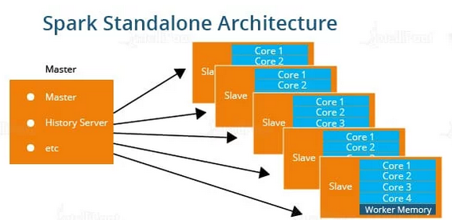

Slide 28

Getting started

Slide 29
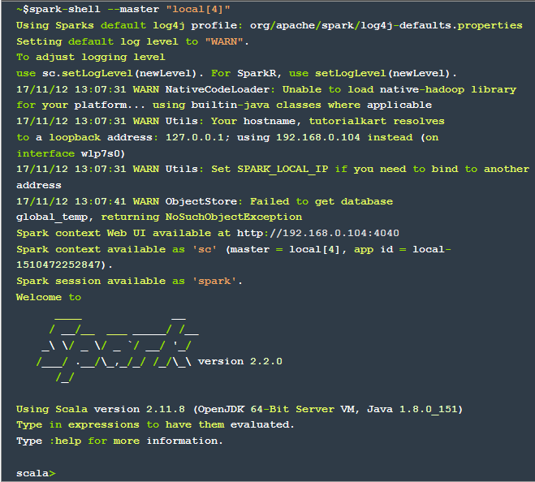

Slide 30
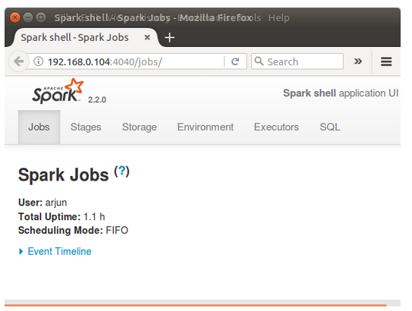
Spark Context Web UI

Slide 31
Spark context available as sc, meaning you may access the spark context in the shell as variable named ‘sc’.
Spark session available as spark, meaning you may access the spark session in the shell as variable named ‘spark’.

Slide 32
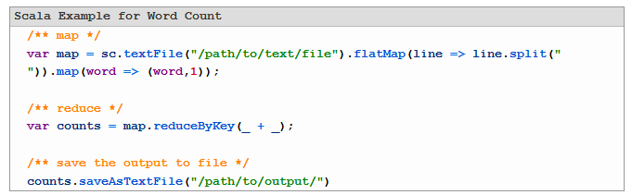
Word-Count Example with Spark (Scala) Shell

Slide 33
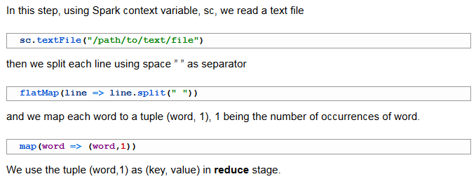
Map

Slide 34


Reduce

Slide 35
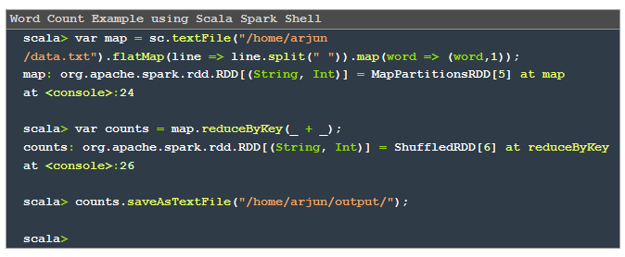

Slide 36
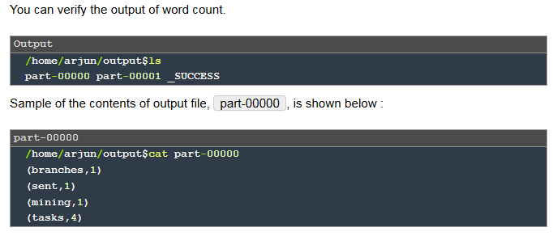

Slide 37
